Slide 1
Image Compression Using Huffman Coding
Deekshith Sandesari

Slide 2
Need for Image compression
Images need large amounts of disk space.
Big disadvantage during transmission & storage.
Image Compression is a process of reducing the size of image at the time of storing on the disk and transmitting the image from one place to another.

Slide 3
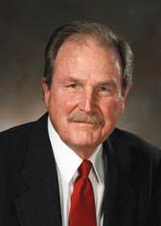
Huffman coding
Huffman coding is a lossless data compression technique used to reduce the size of the image.
It was developed by David A. Huffman while he was a Ph.D. student at MIT, 1952 .
Applications: Supports various file types such as JPEG,MPEG and text files.

Slide 4
Basic Idea of the Algorithm
Not all pixels occur with the same frequency. Yet all pixels are allocated the same amount of space.
Variable length coding
Fixed length coding
Notes:
Variable: Use shorter code words the more frequent gray levels and longer code words for less frequent gray levels.
Fixed: we use 1 byte to store each gray scale.

Slide 5
Encoding

Slide 6
Implementation
Consider an image file in PGM format.
P2
4 4
255
30 30 19 20
50 19 13 19
10 30 13 20
30 30 30 13
Gray-scale Frequency
10 1
50 1
20 2
13 3
19 3
30 6
Notes:
Read the image pixels from the pgm format file.
Find the pixels, which are repeated and calculate the frequency of each of these pixels in the file.
Based on frequency, pixels are arranged in decreasing order. The lower pixel frequencies are merged and this step is continued until only two pixels are left and codes are assigned according to rule that the highest frequency symbol will have a shorter length code.
Then Huffman encoding is performed i.e. mapping of the code words to the corresponding pixels .
Create new file using the Huffman codes, this will result in a compressed data.
Along with this store the frequencies of the pixels.

Slide 7
Using Binary Tree
public class HuffNode {
public int myImg;//grey scale value
public int myFrequency;//frequency
public HuffNode myLeft, myRight;
}
PriorityQueue<HuxffNode> queue = new PriorityQueue<HuffNode>();

Slide 8
Building a Tree
Priority Queue with Nodes
1
10
1
50
2
20
3
13
3
19
6
30
Notes:
Create binary tree nodes with character and frequency of each character
Place nodes in a priority queue
The lower the occurrence, the higher the priority in the queue

Slide 9
Building a Tree..
1
10
1
50
2
20
3
13
3
19
6
30
2
1
10
1
50

Slide 10
Building a Tree..
2
2
20
3
13
3
19
6
30
1
10
1
50

Slide 11
Building a Tree..
3
13
3
19
6
30
4
2
2
10
10
1
50
2
20

Slide 12
Building a Tree..
3
19
6
30
3
13
4
2
2
1
10
1
50
2
20

Slide 13
Building a Tree..
3
19
6
30
3
13
4
2
2
1
10
1
50
2
20
6
3
13
3
19

Slide 14
Building a Tree..
6
6
30
4
2
2
3
13
3
19
1
10
1
50
2
20

Slide 15
Building a Tree..
4
6
6
30
2
2
3
13
3
19
1
10
1
50
2
20

Slide 16
Building a Tree..
4
6
6
30
2
2
10
3
13
3
19
1
10
1
50
2
20
4
6
2
2
1
10
1
50
2
20
3
13
3
19

Slide 17
Building a Tree..
6
30
10
4
6
2
2
1
10
1
50
2
20
3
13
3
19

Slide 18
Final tree
16
6
30
10
4
6
2
2
1
10
1
50
2
20
3
13
3
19

Slide 19

Final tree
16
0
0
6
30
10
1
0
4
6
1
1
0
2
2
1
0
0
1
10
1
50
2
20
0
3
13
3
19
1

Slide 20
Encoding the file
00000111 01010010 01011101 10011101 00000011 00101000 00000110
P2
4 4
255
30 30 19 20
50 19 13 19
10 30 13 20
30 30 30 13
Size reduced to 7 bytes

Slide 21
Compressed File
Add distinct gray levels and frequencies to the file for decompression.
Perform padding
Add the encoded info

Slide 22
Decoding

Slide 23
Decoding
The original image is reconstructed by generating a tree equivalent to the encoding tree.
To construct the tree distinct gray levels and frequencies are retrieved from the compressed file.

Slide 24
Decoding..
Read the input from the file bitwise until last element is reached.
For each bit traverse the tree to get the pixel encode in the leaf and return to the root
Continue this process until all the codes of corresponding pixels are known.

Slide 25
Decoding..
Once we have tree we scan bit stream.
0 ⇒ go left
1 ⇒ go right
16
0
0
30
6
10
1
00000111 01010010 01011101 10011101 00000011 00101000 00000110
0
4
6
1
0
2
2
1
1
0
0
1
10
1
50
2
20
0
3
13
3
19
1
30 30 19 20
50 19 13 19
10 30 13 20
30 30 30 13

Slide 26
Demo

Slide 27
Results and Analysis

Slide 28
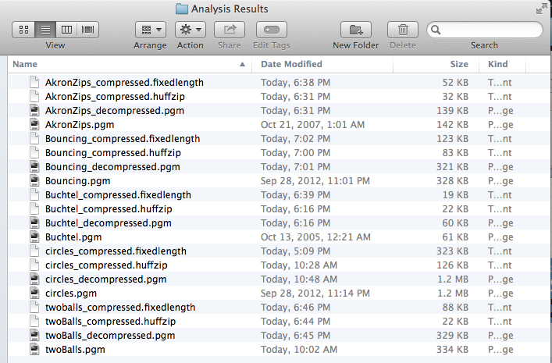
Results

Slide 29
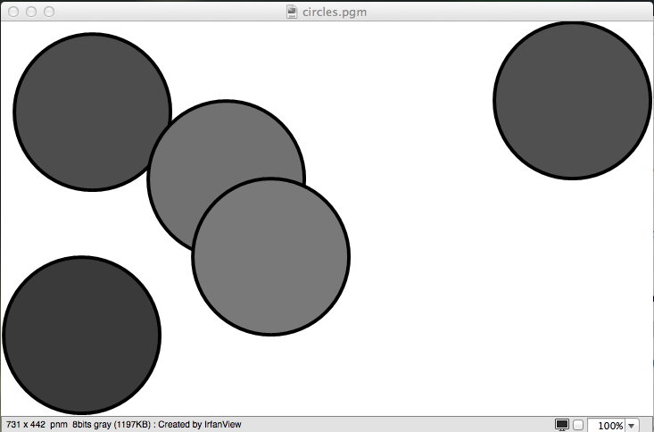
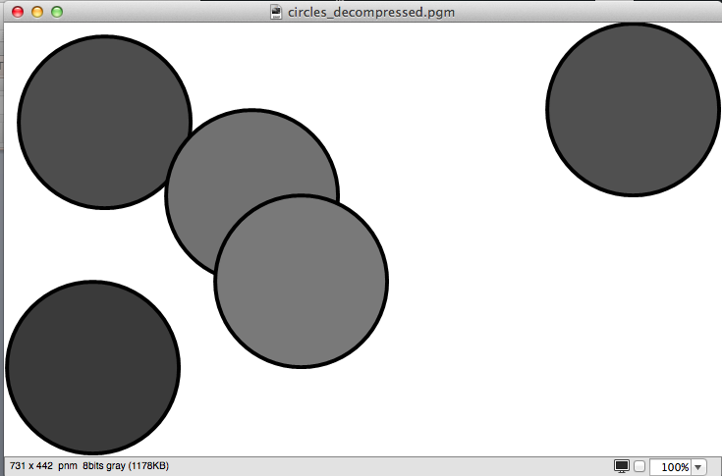
Compressed and Decompressed file

Slide 30
Empirical Analysis
 |  | Huffman Variable Length Coding |  | Fixed Length Coding
Image | Original size (kb) | Compressed size(kb) | Decompressed size(kb) | Compressed size(kb)
Bug | 7 | 1 | 6 | 2
Akron Zips | 142 | 32 | 139 | 52
Bouncing | 328 | 83 | 321 | 123
Two balls | 334 | 22 | 329 | 88
Circles | 1197 | 126 | 1178 | 323

Slide 31
Conclusion
Huffman is very much effective and hence widely used in all the mainstream compression formats that you might encounter - from GZIP, PKZIP (winzip etc) and BZIP2, to image formats such as JPEG and PNG.

Slide 32

Questions?

